Slide 1

WEB DEVELOPMENT (Smart Shopping Cart)
ONLINE INTERNSHIP
PRESENTATION
ON
VAGGE REEMA RANI
EXPOSYS DATA LABS
WEB DEVELOPMENT

Slide 2
CONTENTS
INTRODUCTION
WEB DEVELOPMENT
WEB DEVELOPMENT PROCESS
HARDWARE AND SOFTWARE REQUIREMENTS
SMART SHOPPING CART (SSC)
APPLICATIONS
REFERENCES

Slide 3
INTRODUCTION
The business-to-consumer aspect of an online shopping is the most visible business use of the World Wide Web. The primary goal of an online shopping site is to sell goods and services online.
This project deals with developing an e-commerce website for online shopping.
To facilitate online purchase a shopping cart is provided to the user. The system is implemented using a web browser as the front-end client.

Slide 4
INRODUCTION
We used HTML, CSS, Java Script for developing this website.
This Project presents a preliminary development of the smart shopping cart (SSC) that can be integrated into the smart mall system.
The SSC can provide customers with the efficient user interface so that the shopping service can be effectively promoted.

Slide 5
WEB DEVELOPMENT
Web development is a broad term for the work involved in developing a web site for the internet (World Wide Web) or an intranet (a private network).
Web development can range from developing the simplest static single page of plain text so the most complex web-based internet applications (or just ‘web apps’) electronic businesses, and social network services.
A more comprehensive list of tasks to which web development commonly refers, may include web engineering, web design, web content development, client liaison, client- side server-side scripting, web server and network security configuration, and- commerce development.
Among web professionals, “web development” usually refers to the main non-design aspects of building web sites, writing markup and coding.

Slide 6

WEB DEVELOPMENT PROCESS
Decide Purpose
Planning
Designing
Gather Content
Building
Testing
Upload to Server
Marketing & Maintenance

Slide 7
HARDWARE AND SOFTWARE REQUIREMENTS
Windows 7 or above
VISUAL STUDIO
HTML
CSS
JAVA SCRIPT
BOOTSTRAP

Slide 8
SMART SHOPPING CART (SSC)
My Website consists of
Index Page (Main Page or Home Page)
Blog Page
Contact Page
Server Page
About Us Page
Register & Login Page
Feedback Forms in every page

Slide 9
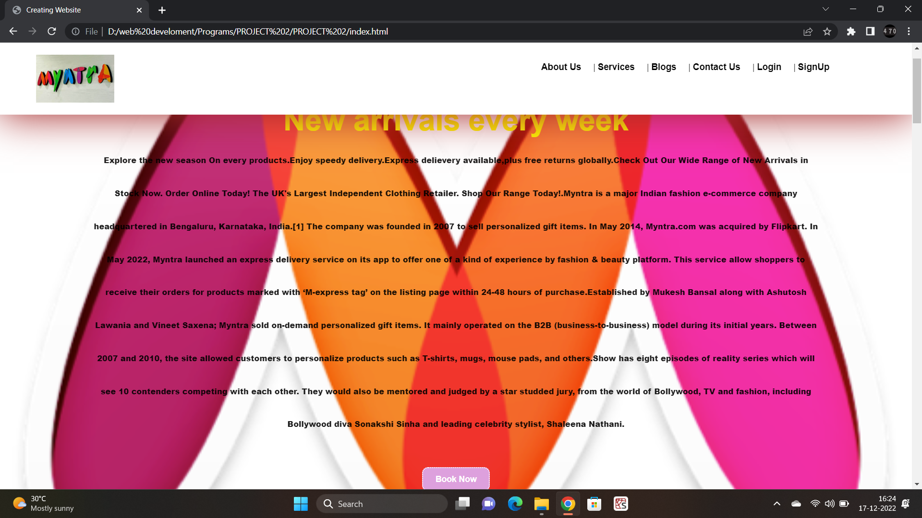
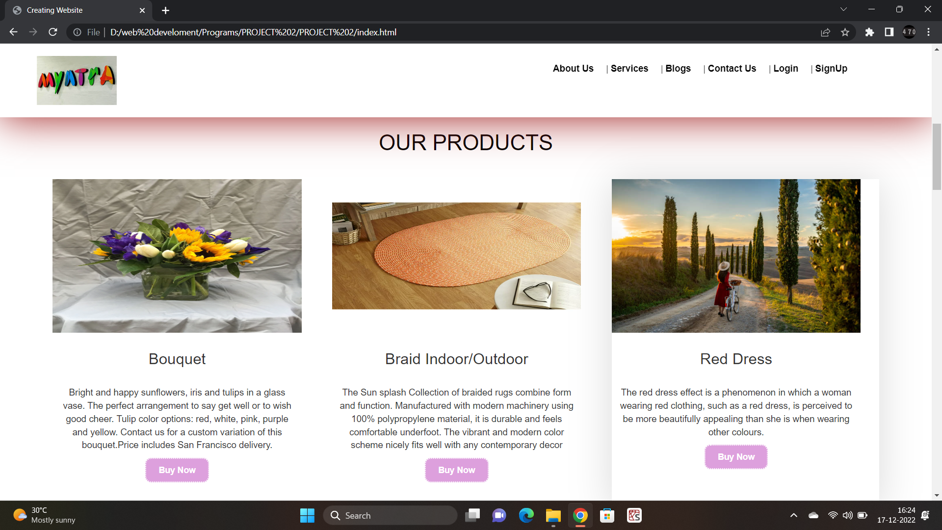
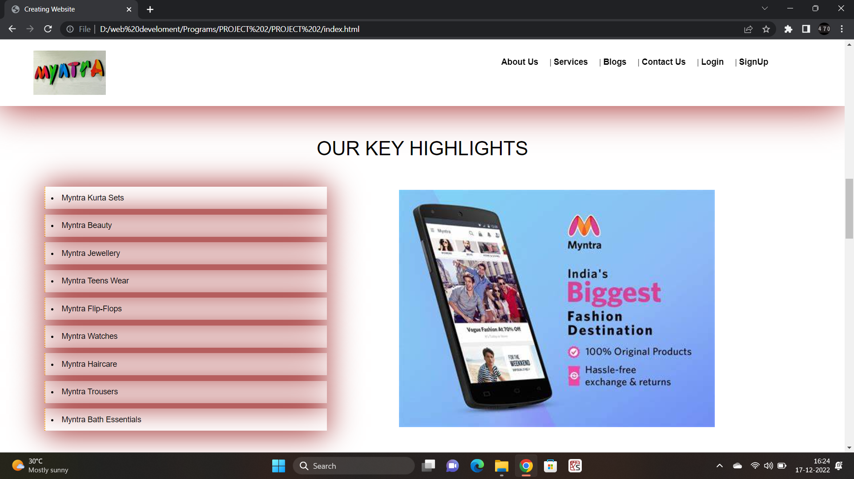
Index Page
Contents in Index Page are
Navigation Tag
Logo
Background Designs
Grid Displays
Buttons
Pictures
Lists

Slide 10
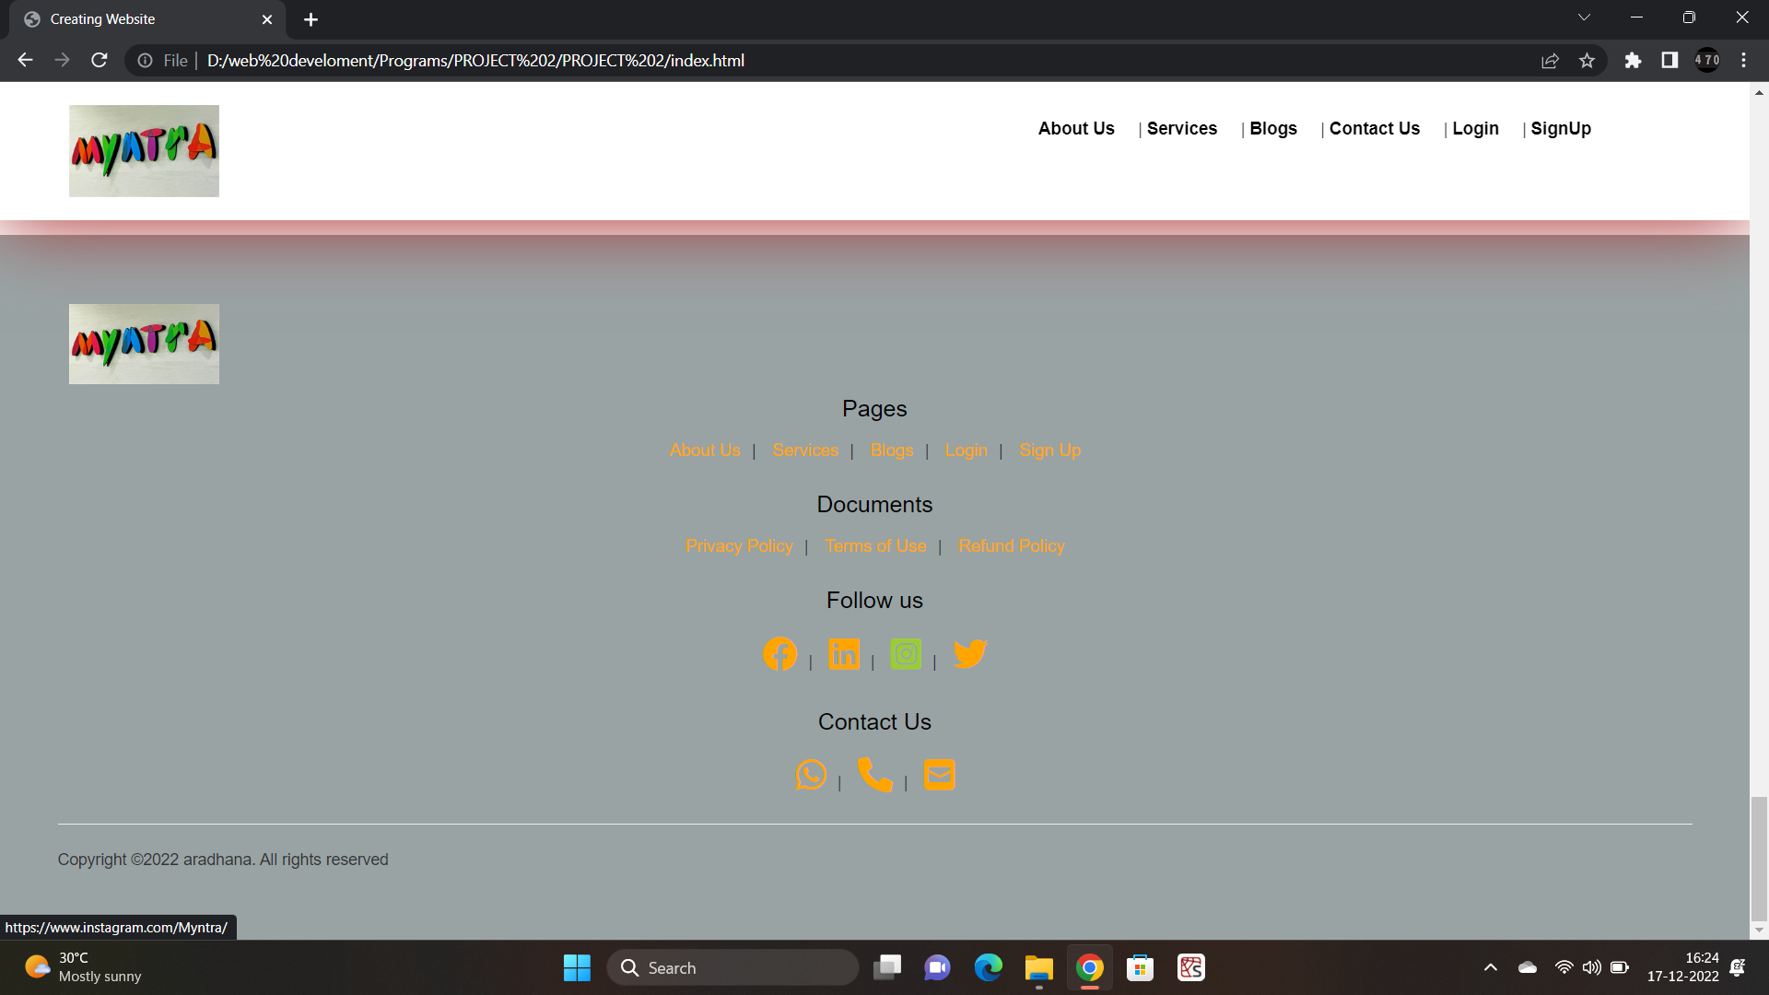
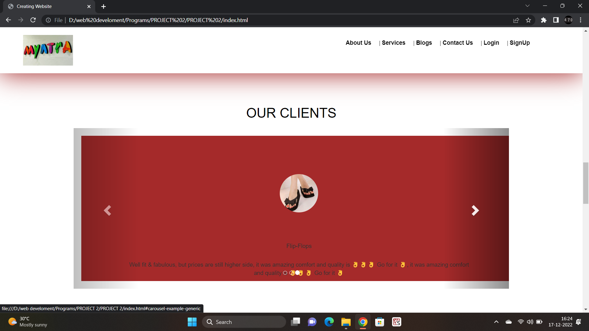
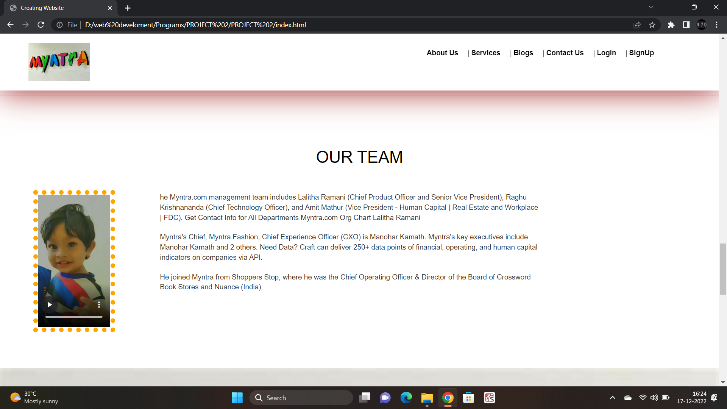
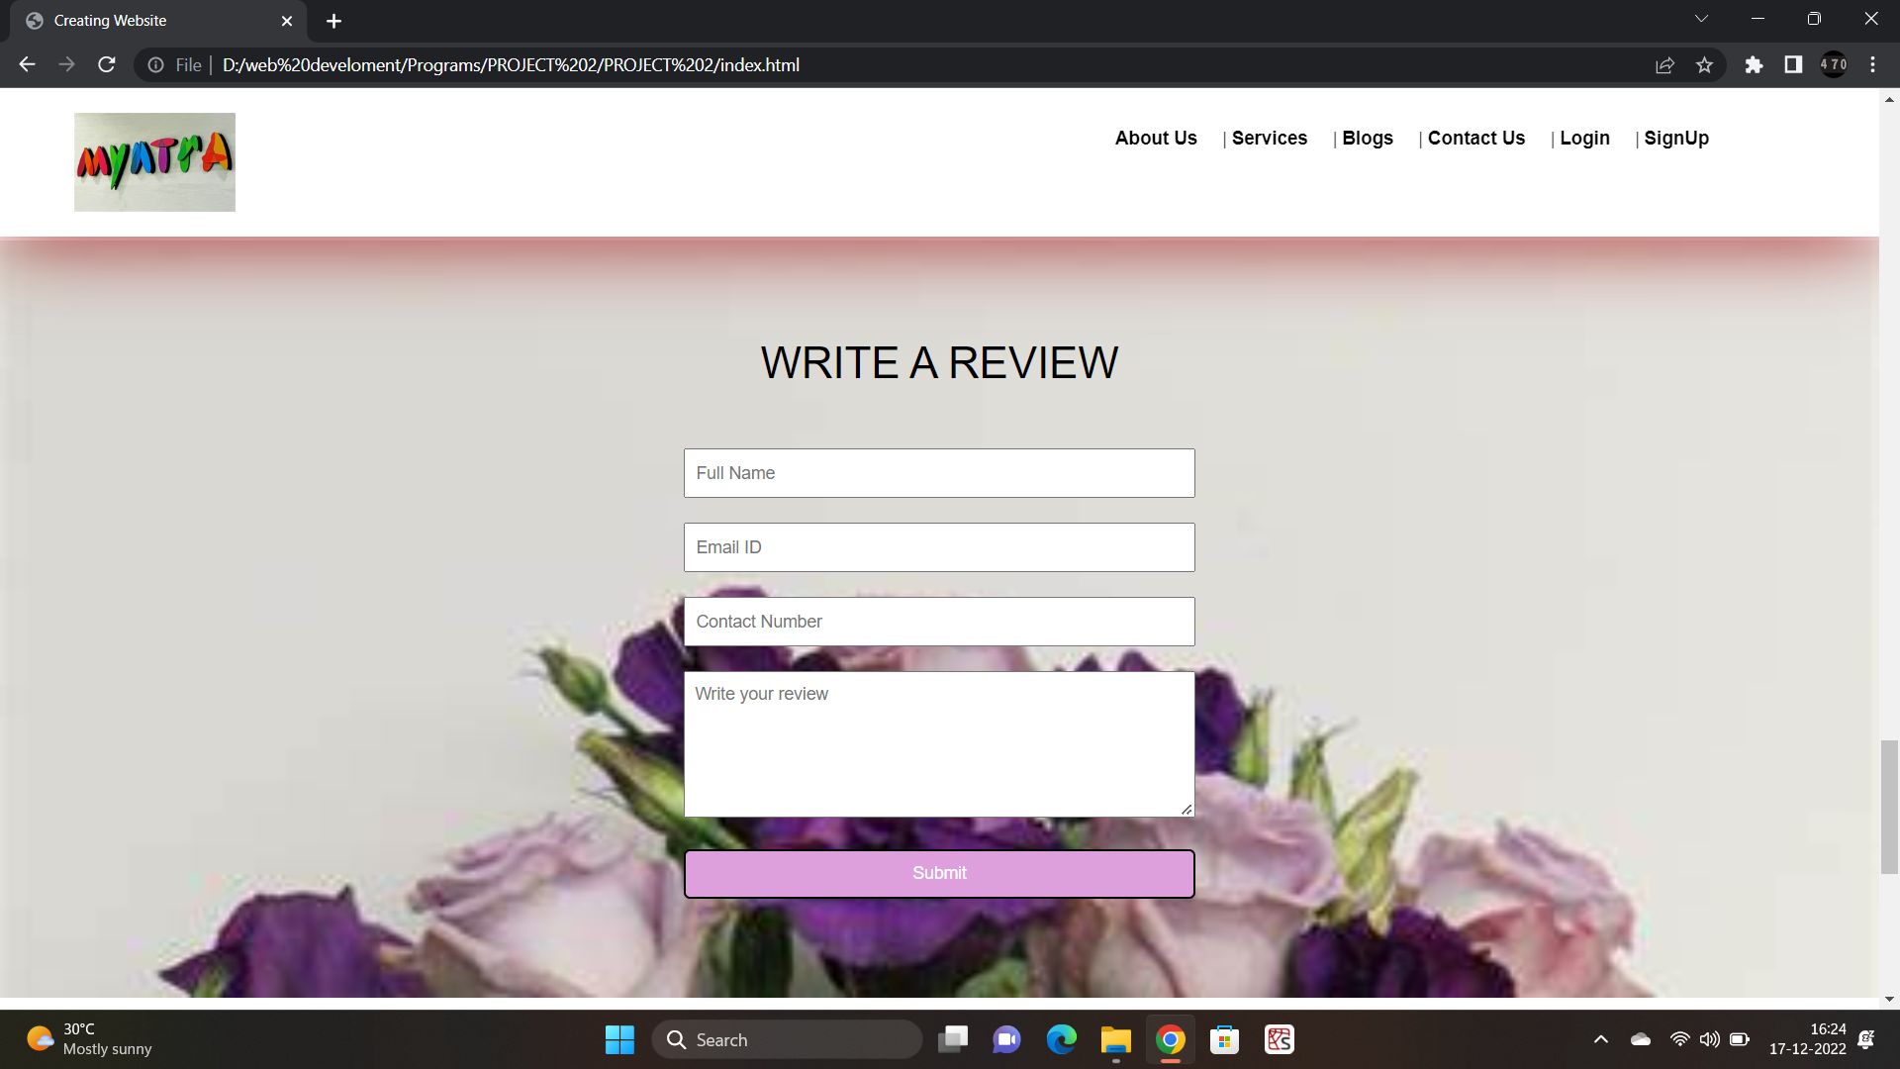
Slide Shows
Text Slides
Borders
Video (Downloaded or Uploaded from Youtube)
Feedback form using JAVASCRIPT
Inputs
Footer
Links
Common for ALL PAGES

Slide 11
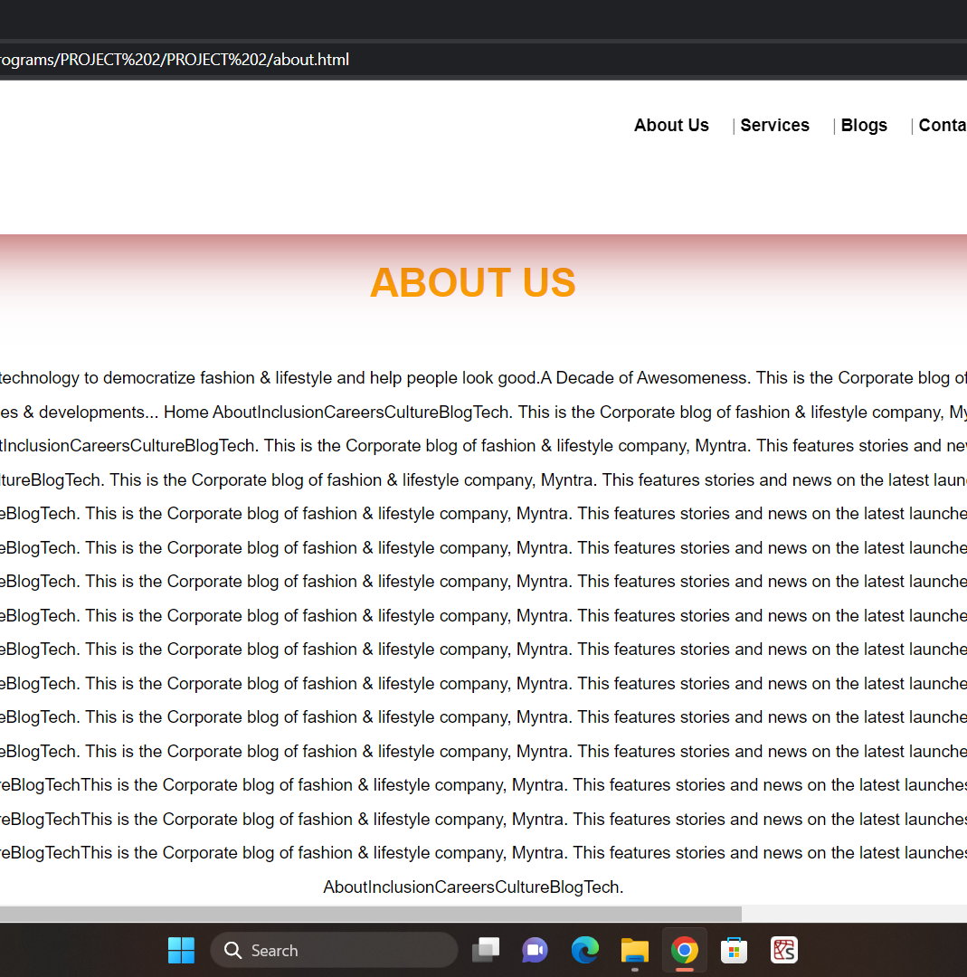
About Us Page
About Us page consists of
About the Website details
Feedback Form
Footer

Slide 12
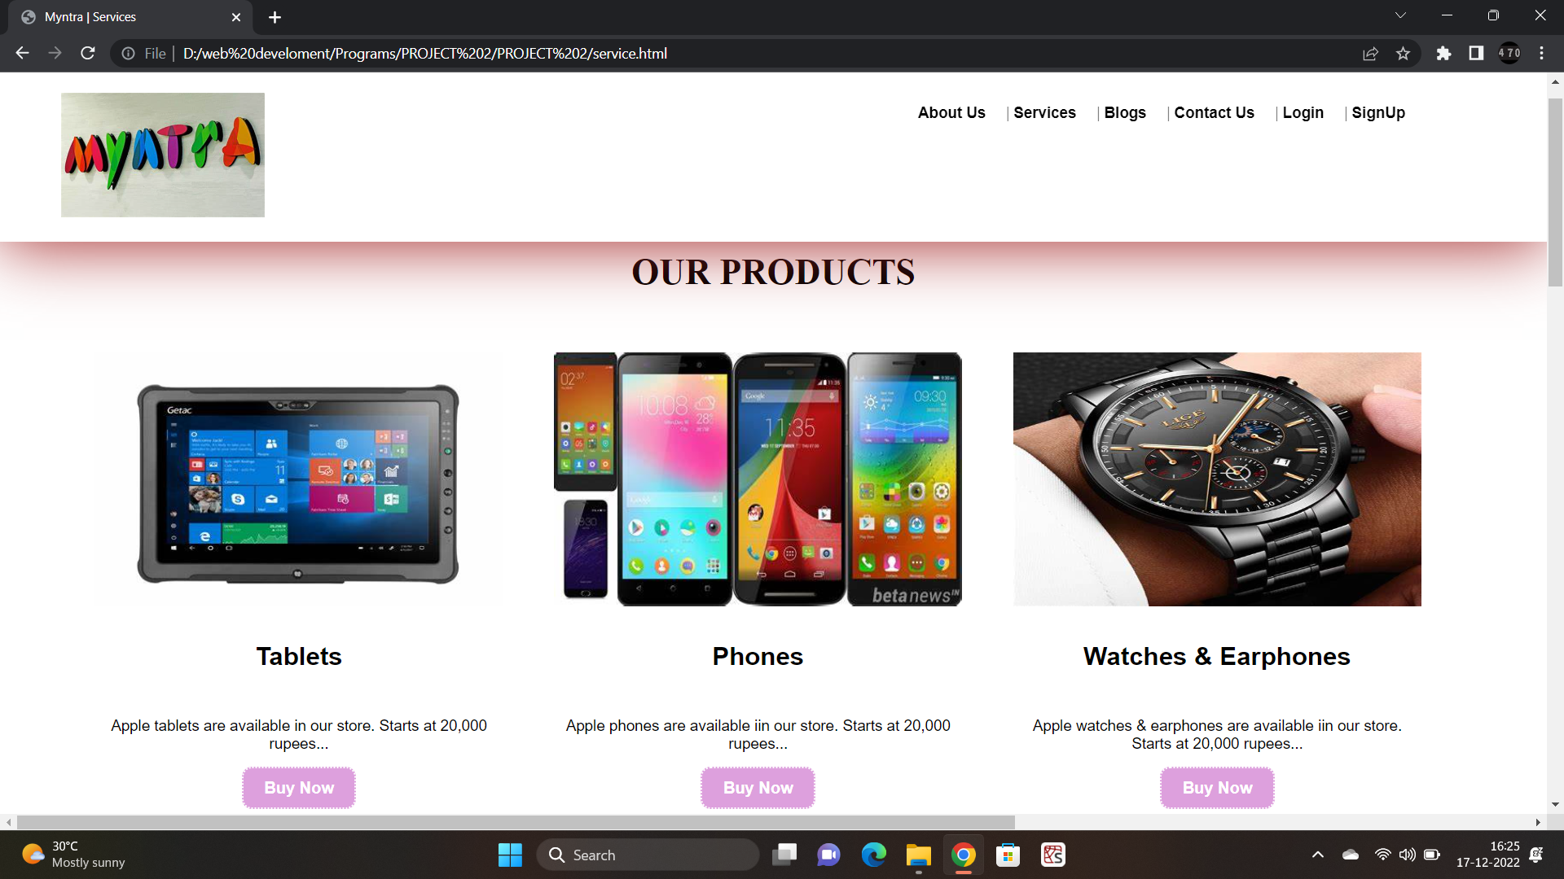
Services Page
Services Page consists of
Different products that are sold in the website
Button for buying the product
The description of the product
Feedback Form
Footer

Slide 13
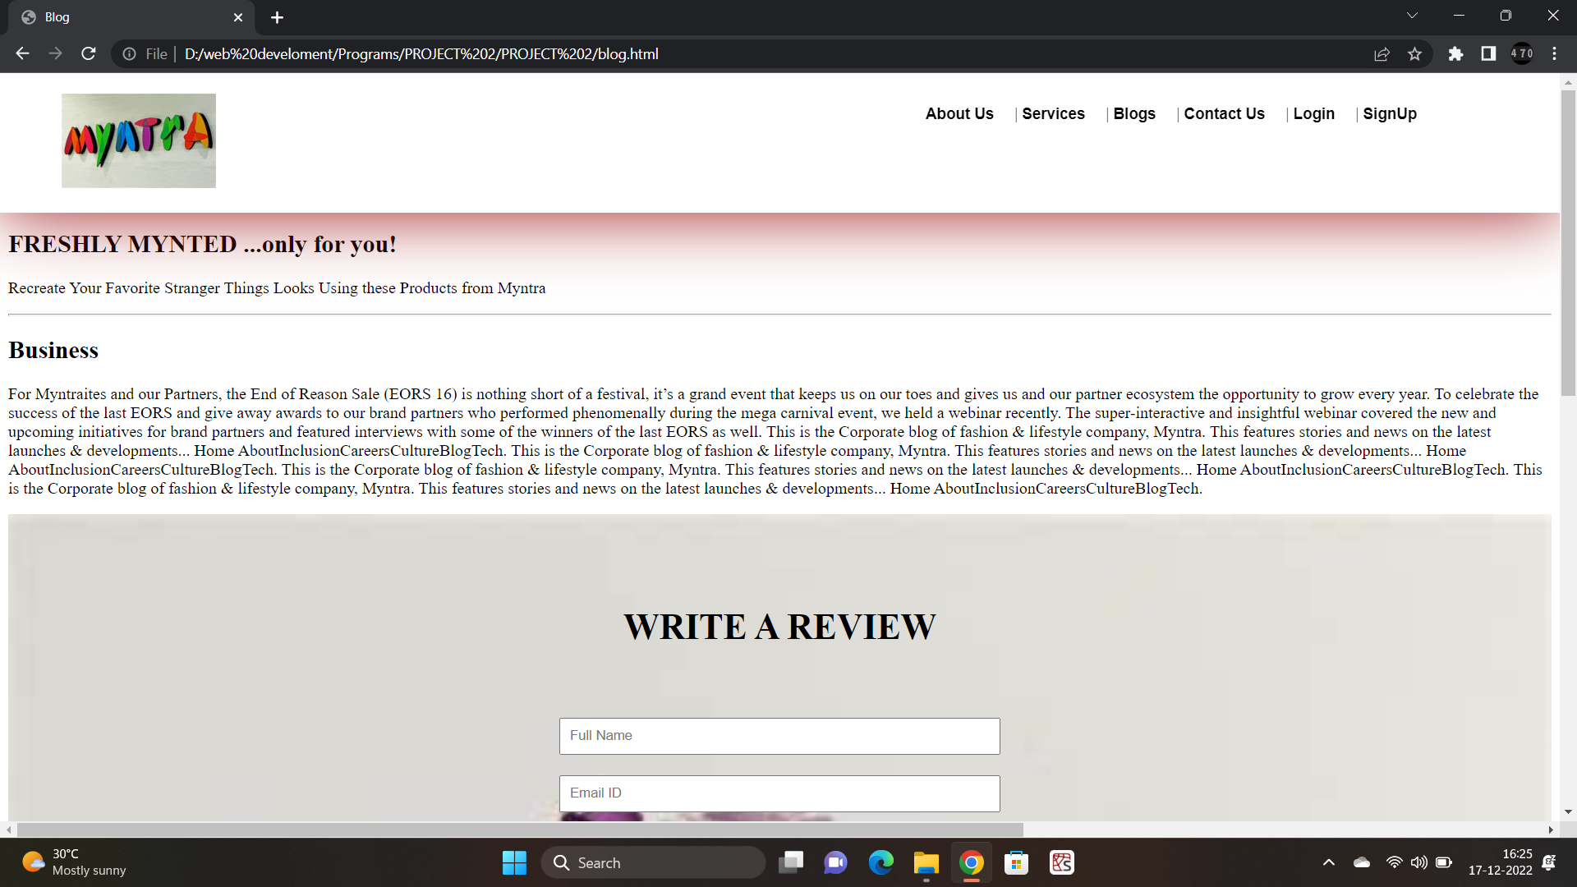
Blog Page
Blog Page consists of
The different Blogs
The Details of the Business
Feedback Form
Footer

Slide 14
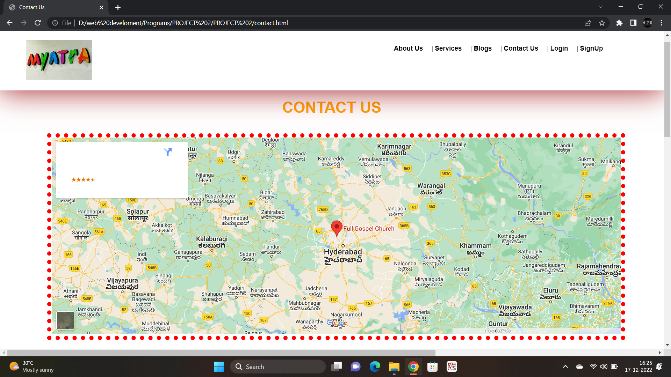
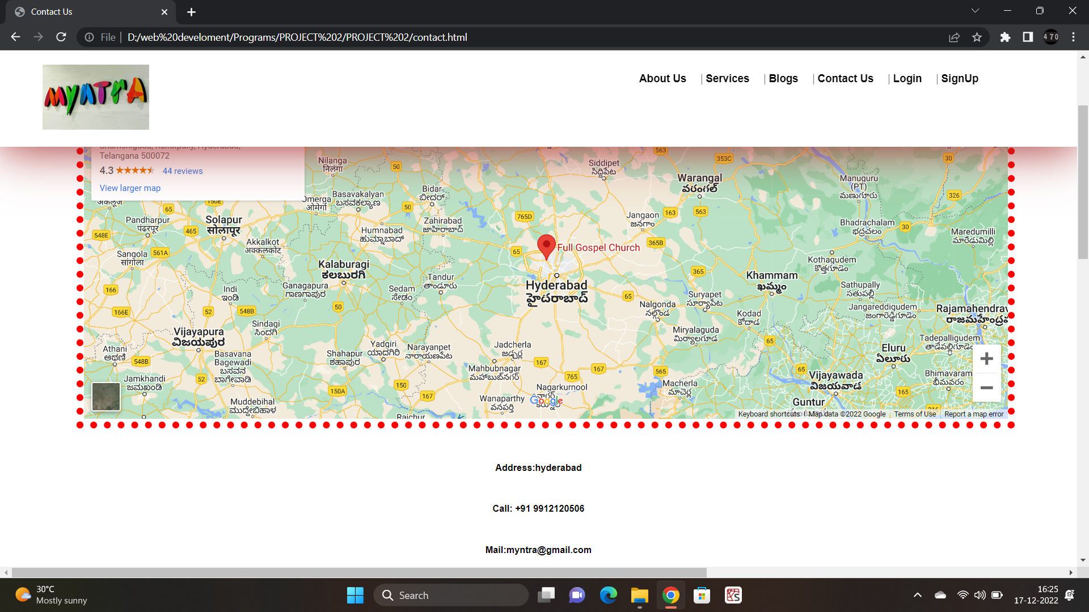
Contact us Page
Contact Us Page consists of :
The location of the Main Centre of SSC.
Address
Contact
Mail
Feedback Form
Footer

Slide 15
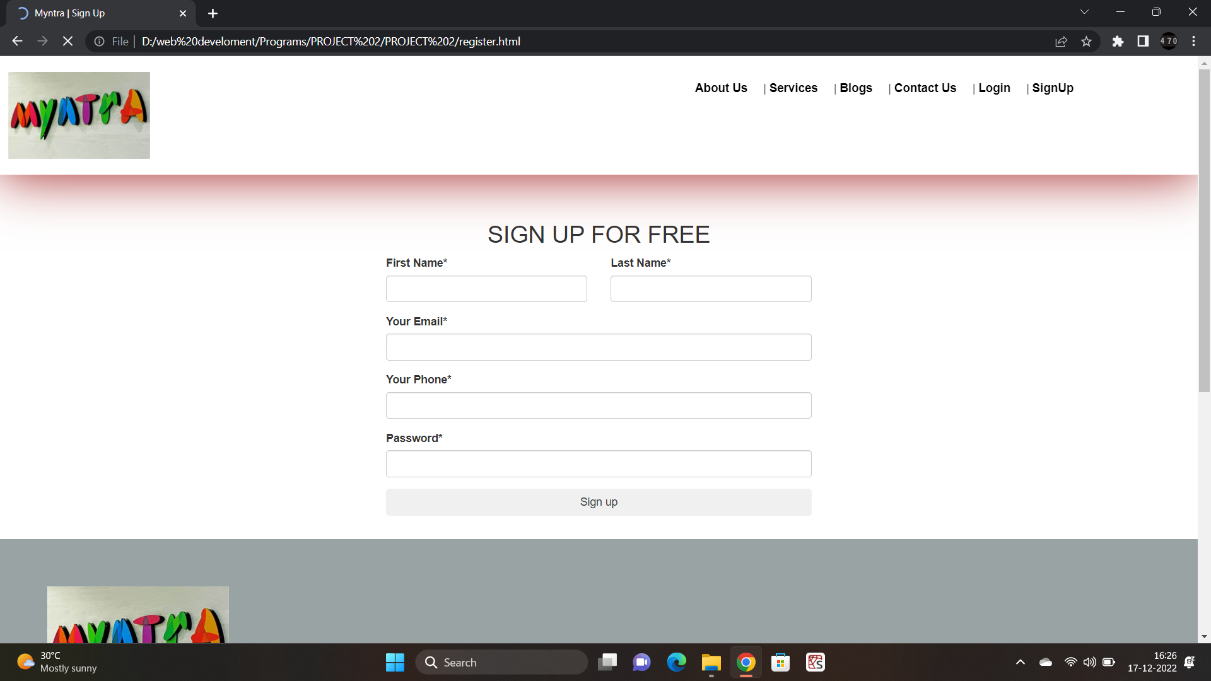
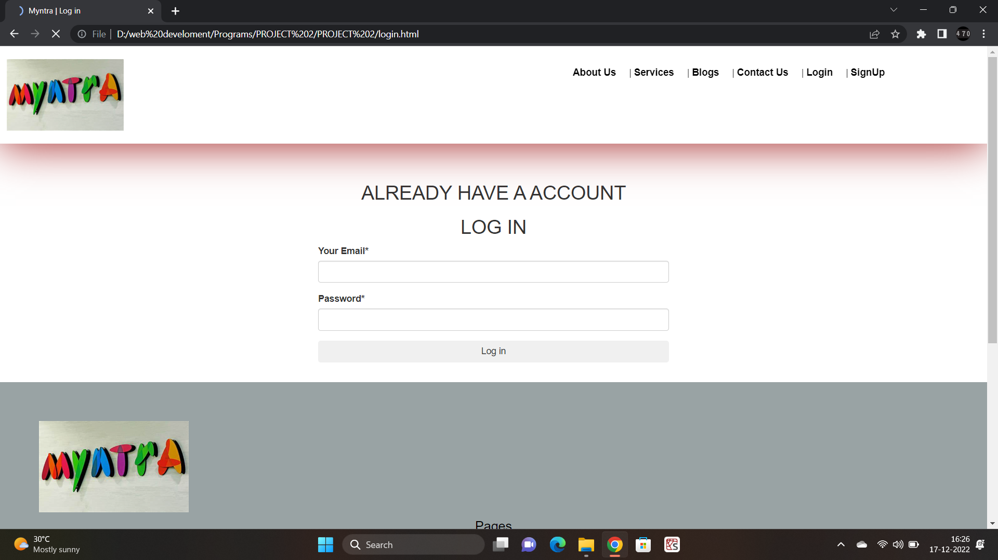
Login & Register Form
Login & Register Page consists of
Register Page
Login Page
Footer in both pages

Slide 16
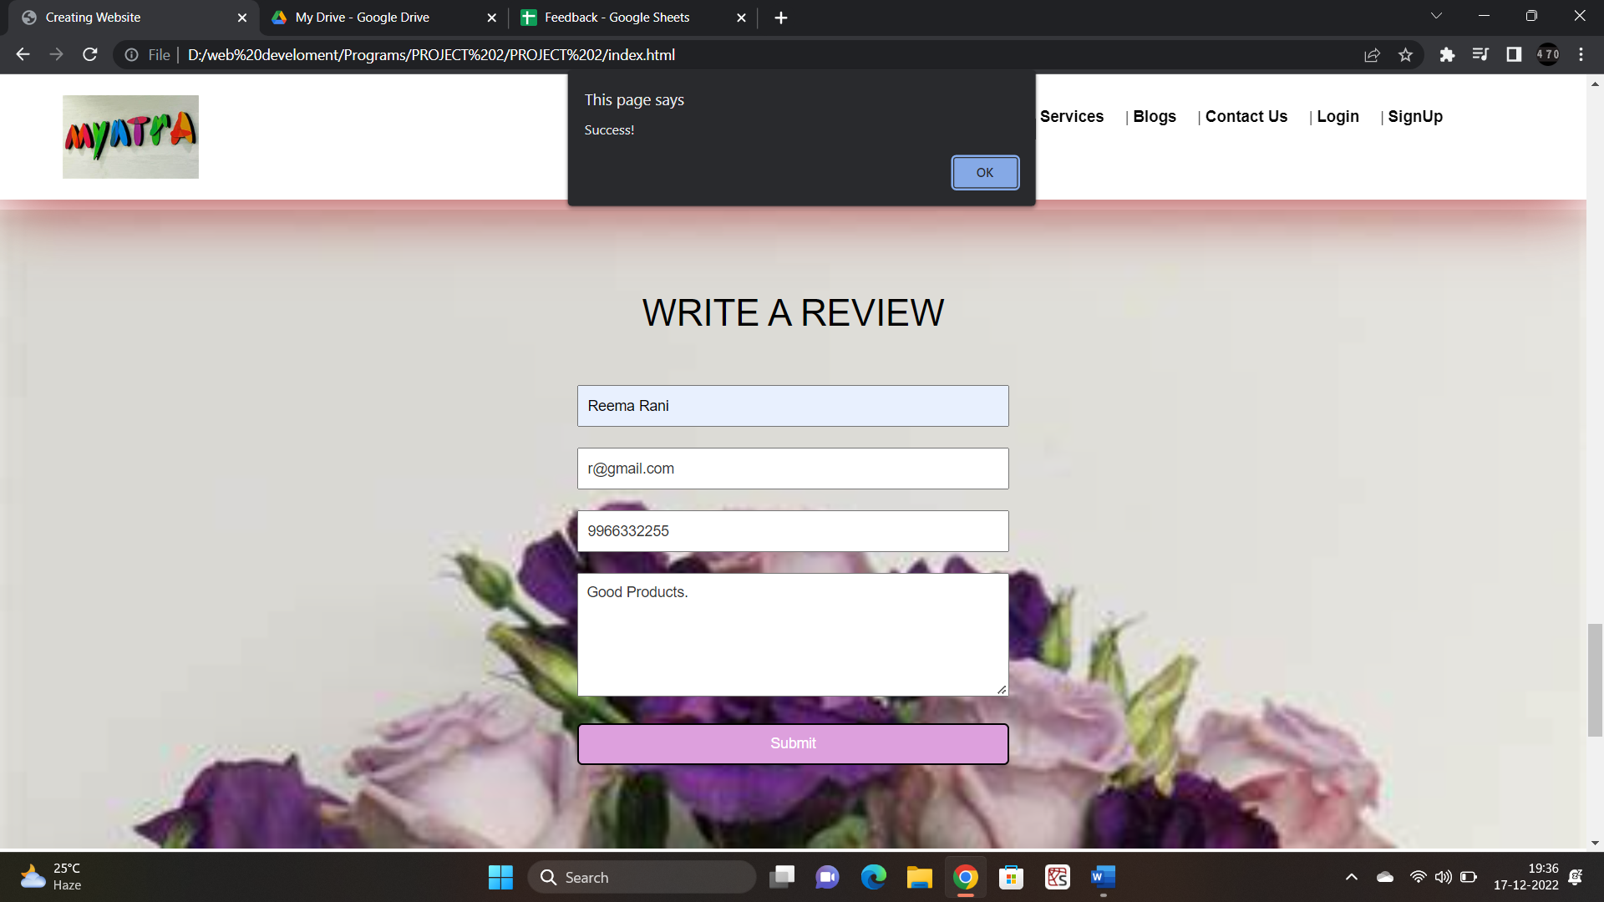
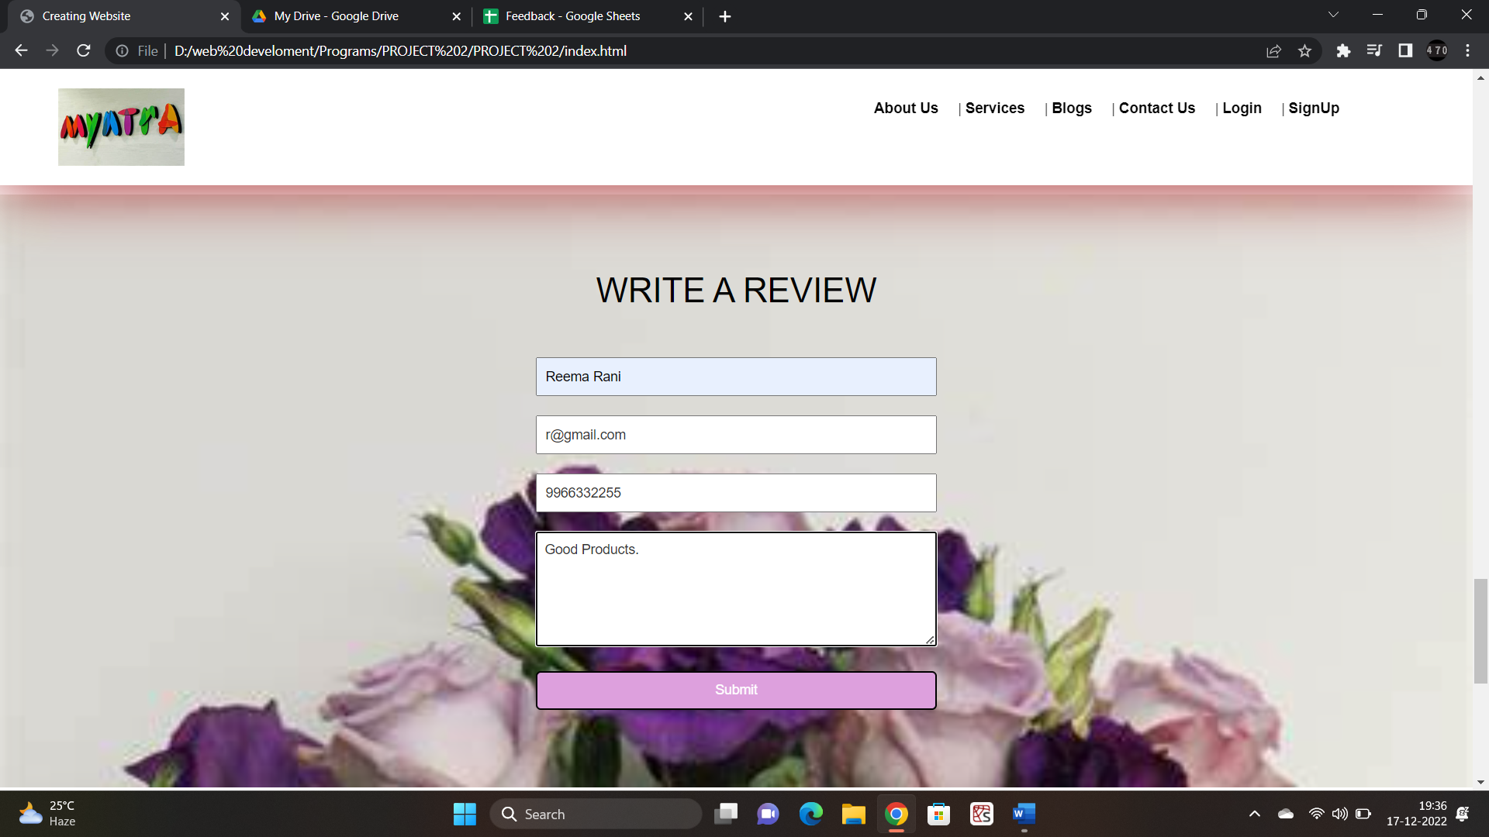
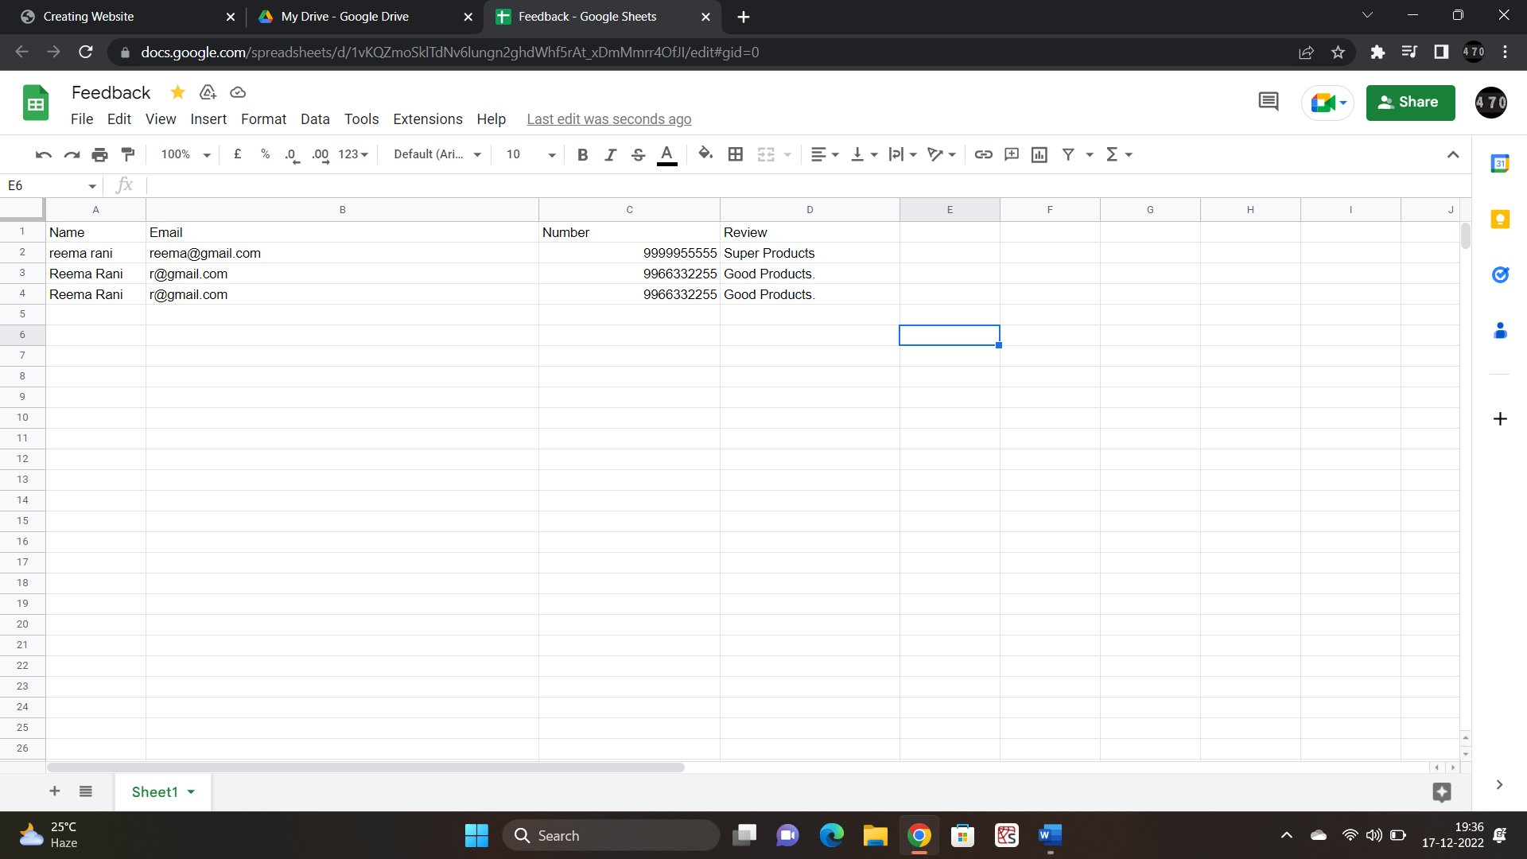
Feedback Form
First Data is entered in the Feedback boxes.
If data is improper – Displays error.
After Submission – Popup shows on page.
Data is entered using APPSCRIPT in XLSHEET.

Slide 17
APPLICATIONS
The Smart Shopping Cart application allowed supermarkets to increase sales, providing them with the opportunity to influence shoppers at the point of making a buying decision.
Brands and suppliers were given the opportunity to increase brand awareness via in-app ads.
Payment Gateways The e-commerce shopping cart solution is integrated with multiple payment gateways to allow users to pay using the option they find convenient.
Checkout The products added to the shopping cart can be readily processed for checkout.
Technology has improved the speed, efficiency, and effectiveness of the shopping experience.

Slide 18

REFERENCES
1stop.ai classes
Bootstrap
Font Awesome

Slide 19

This Photo by Unknown author is licensed under CC BY-SA.

